Slide 1
Computer Vision Interpretability
Making Models Trustworthy

Slide 2
What to Expect
By the end of this talk, you will know
Why do we need Model Interpretability ?
What is model Interpretability ?
Types/Stages in improving model Interpretability ?
How to improve model accuracy using Interpretability ?
Experiments with model Interpretability
Toolkits for CV interpretability : Torch vision, Boilerplate codes in TF & Pytorch

Slide 3
What is model Interpretability ?
Explaining the reasoning behind the Model’s decision
What Features or group of features attributed/caused the decision
Local and global impact of features
Model Invariance
What does the model look for in an image/data

Slide 4
Why Interpretability ?
Most of the models are judged based on accuracy metrics such as precision and recall of validation and test set.
While it is important to note the model accuracy scores, we have no way to check why the model responded the way it did.
Deploying any real-world safety-critical applications without understanding the models in depth can have unintended side effects.
Model Interpretability gives us the ability to understand the reasoning behind the model’s decision.

Slide 5
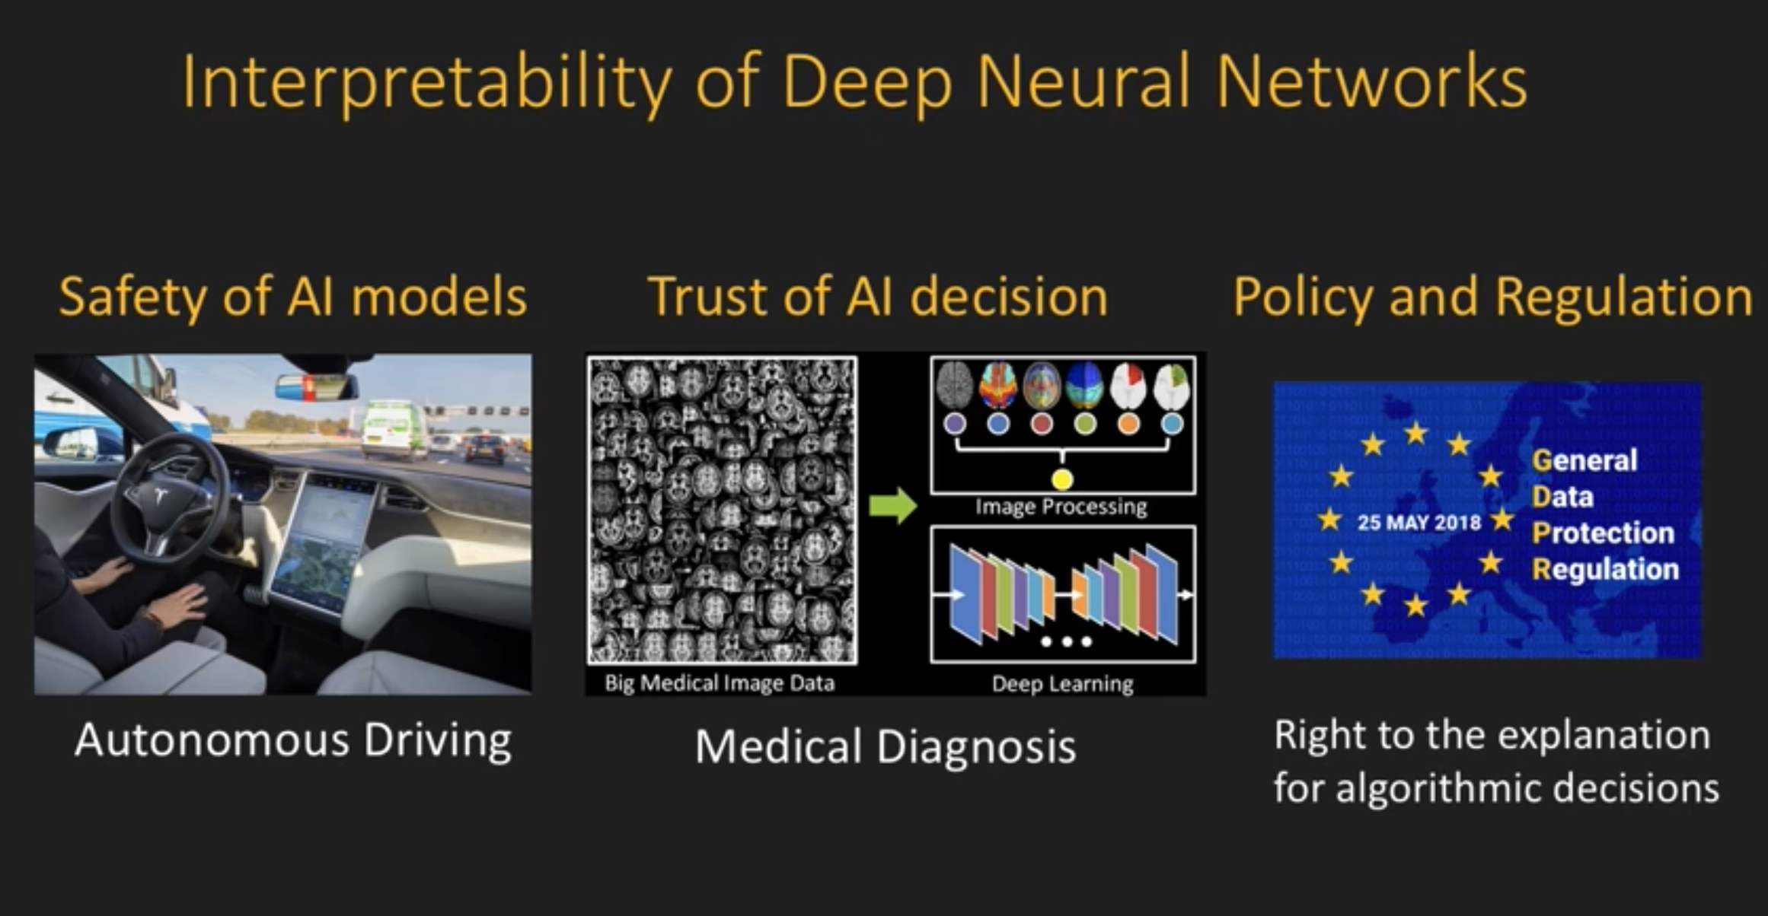
Stronger Case for Model Interpretability

Slide 6
Model Interpretability Stages
Before Training
During Training
After Training

Slide 7
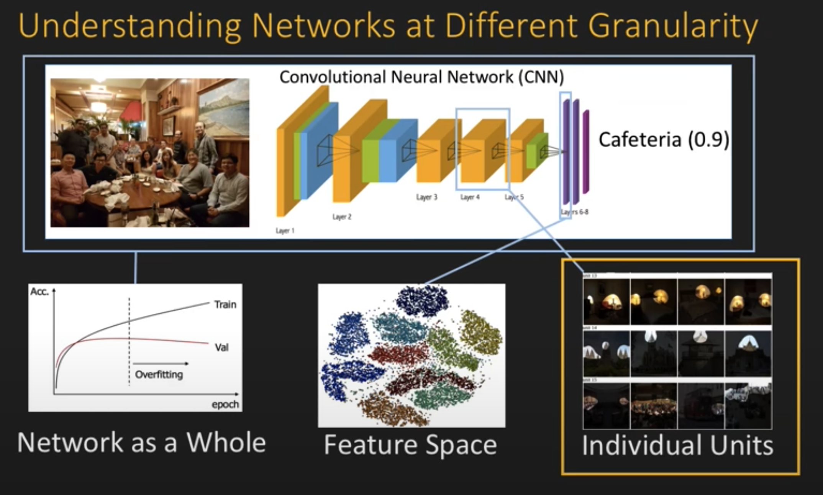
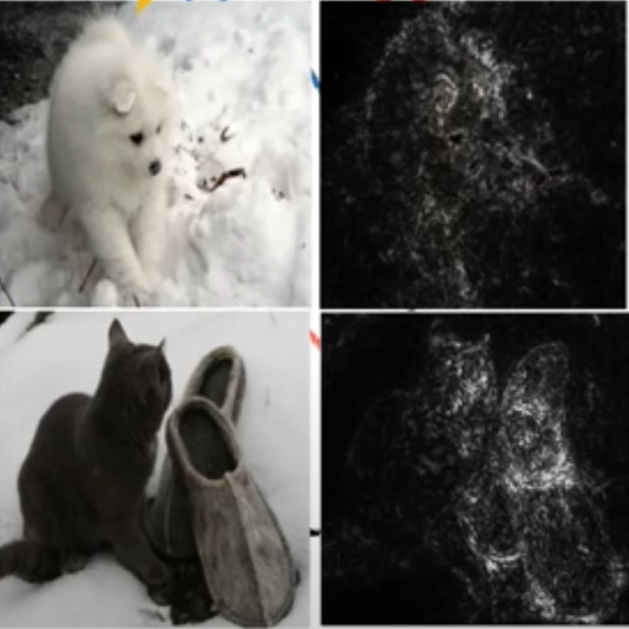
Interpretability Techniques In CV
Semantic Maps
Feature Space approaches
Generative Techniques
Unit and layer analysis and visualization

Slide 8
CV Saliency - Comparison
Techniques to catch Saliency Maps
Grad Cam
Full Grad
Integrated gradient
Input Gradient
Deep Taylor
Deep Lift
…
Core Elements behind the techniques
Gradient
SmoothGrad
Deconvnet
Guided Backprop
BackProp

Slide 9
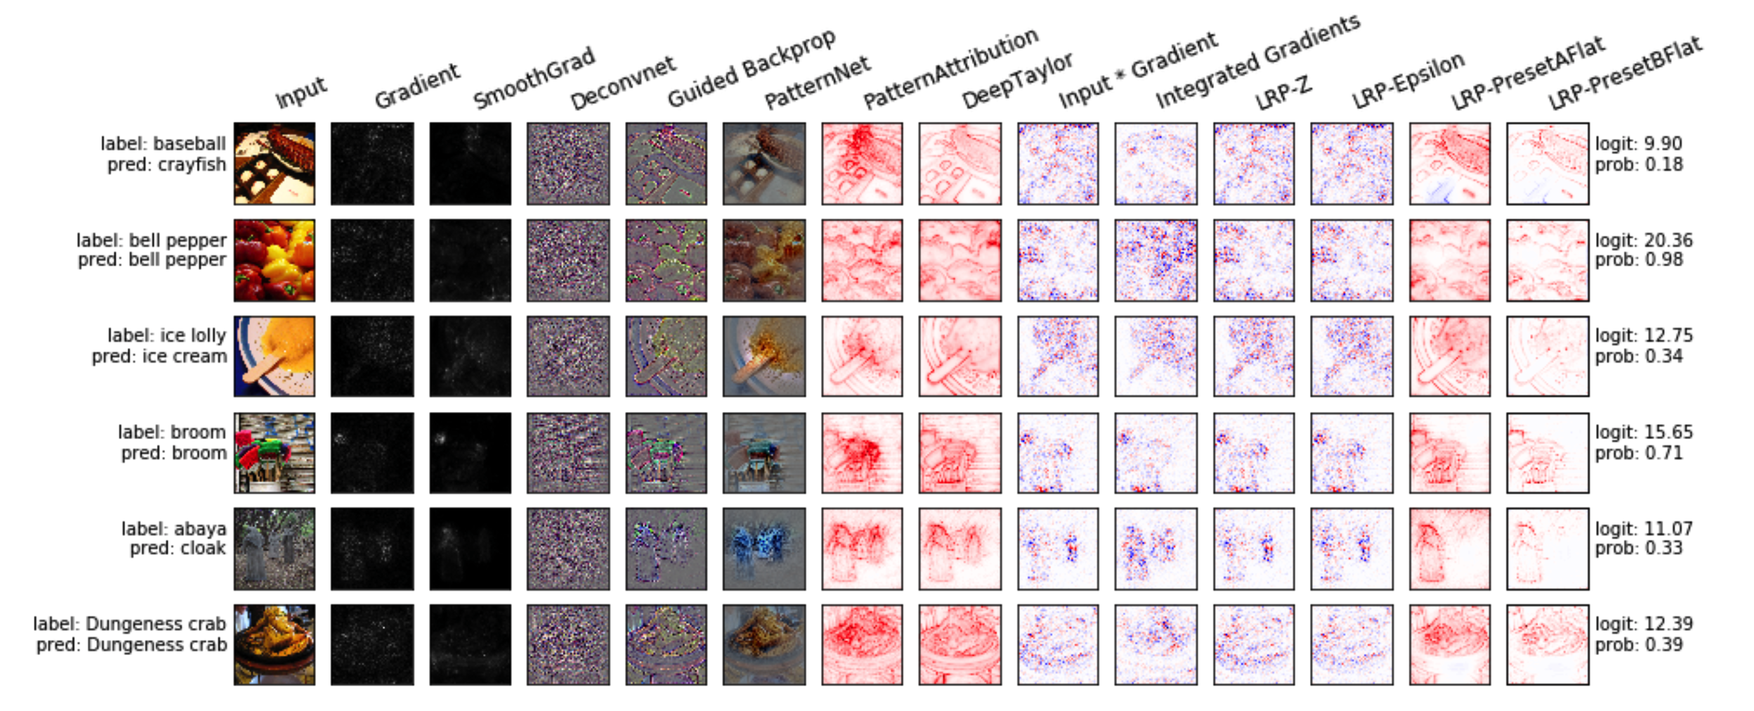
Experiments

Slide 10
Good Practices and ways to improve Model
Step 1:
EDA
Model Training Hyperparameters
Step 2:
Model Accuracy scores – ROC and more
Step 3:
Visual Inspection: using Integrated Gradient or other approaches
Saliency map analysis on train data ( for combination of class labels)
Step 4
Identify areas of concern using Saliency maps and accuracy scores
Step 5 (If concerns don’t show up on saliency maps ) else step 6
Pixel Perturbation – Full Grad (or)
Step 6
Fix the issue by augmentation/adding/removing Data
Fine tune the model and go to step 1

Slide 11
Python in Use
Python + Jupyter notebooks comes in handy to generate and visualize saliency maps and intra model layers.
Generating special saliency map yard sticks and using those yard sticks to validate future model roll-outs is possible with the help of python pipeline.
It is easy to store the model evaluation results in Python data frame and analyze the reason for failure.
All of the functionalities in the proposed idea greatly rely on packages available in Python.

Slide 12
Thank You!

Slide 13
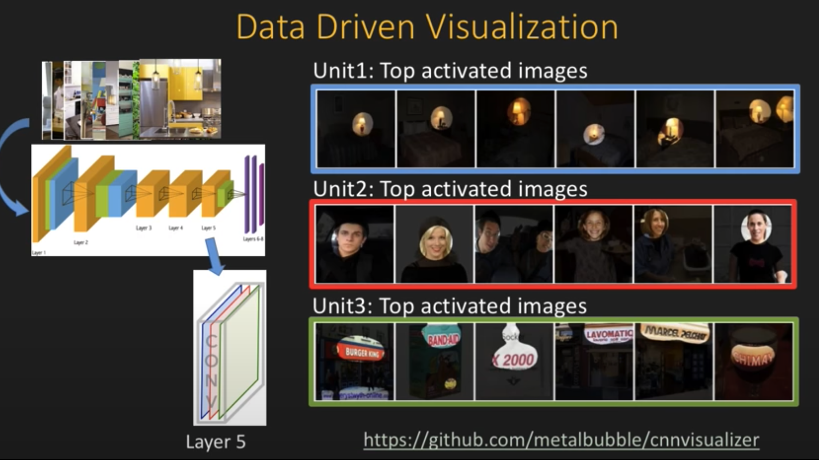
visualization

Slide 14
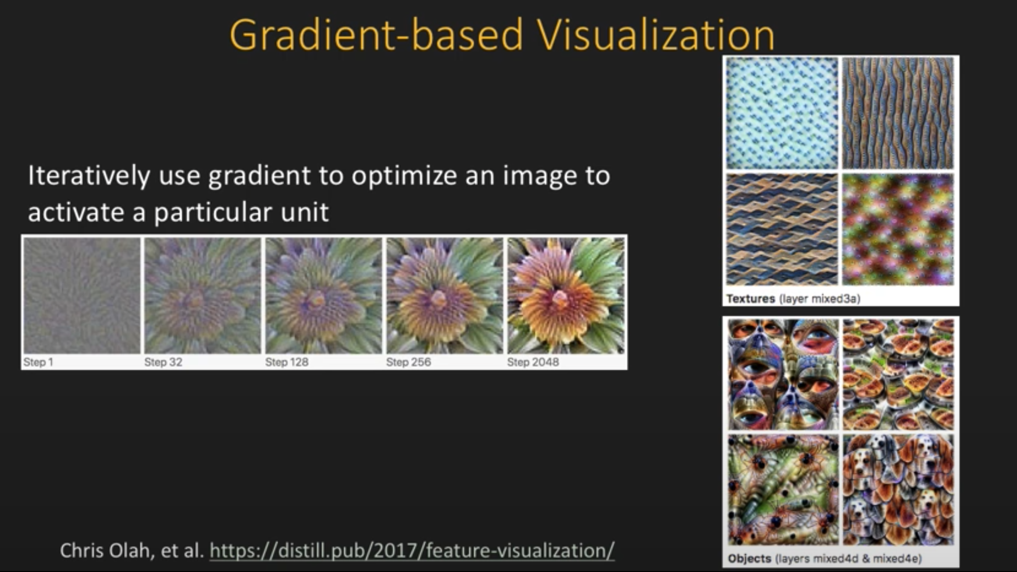
Gradient Based visualization

Slide 15
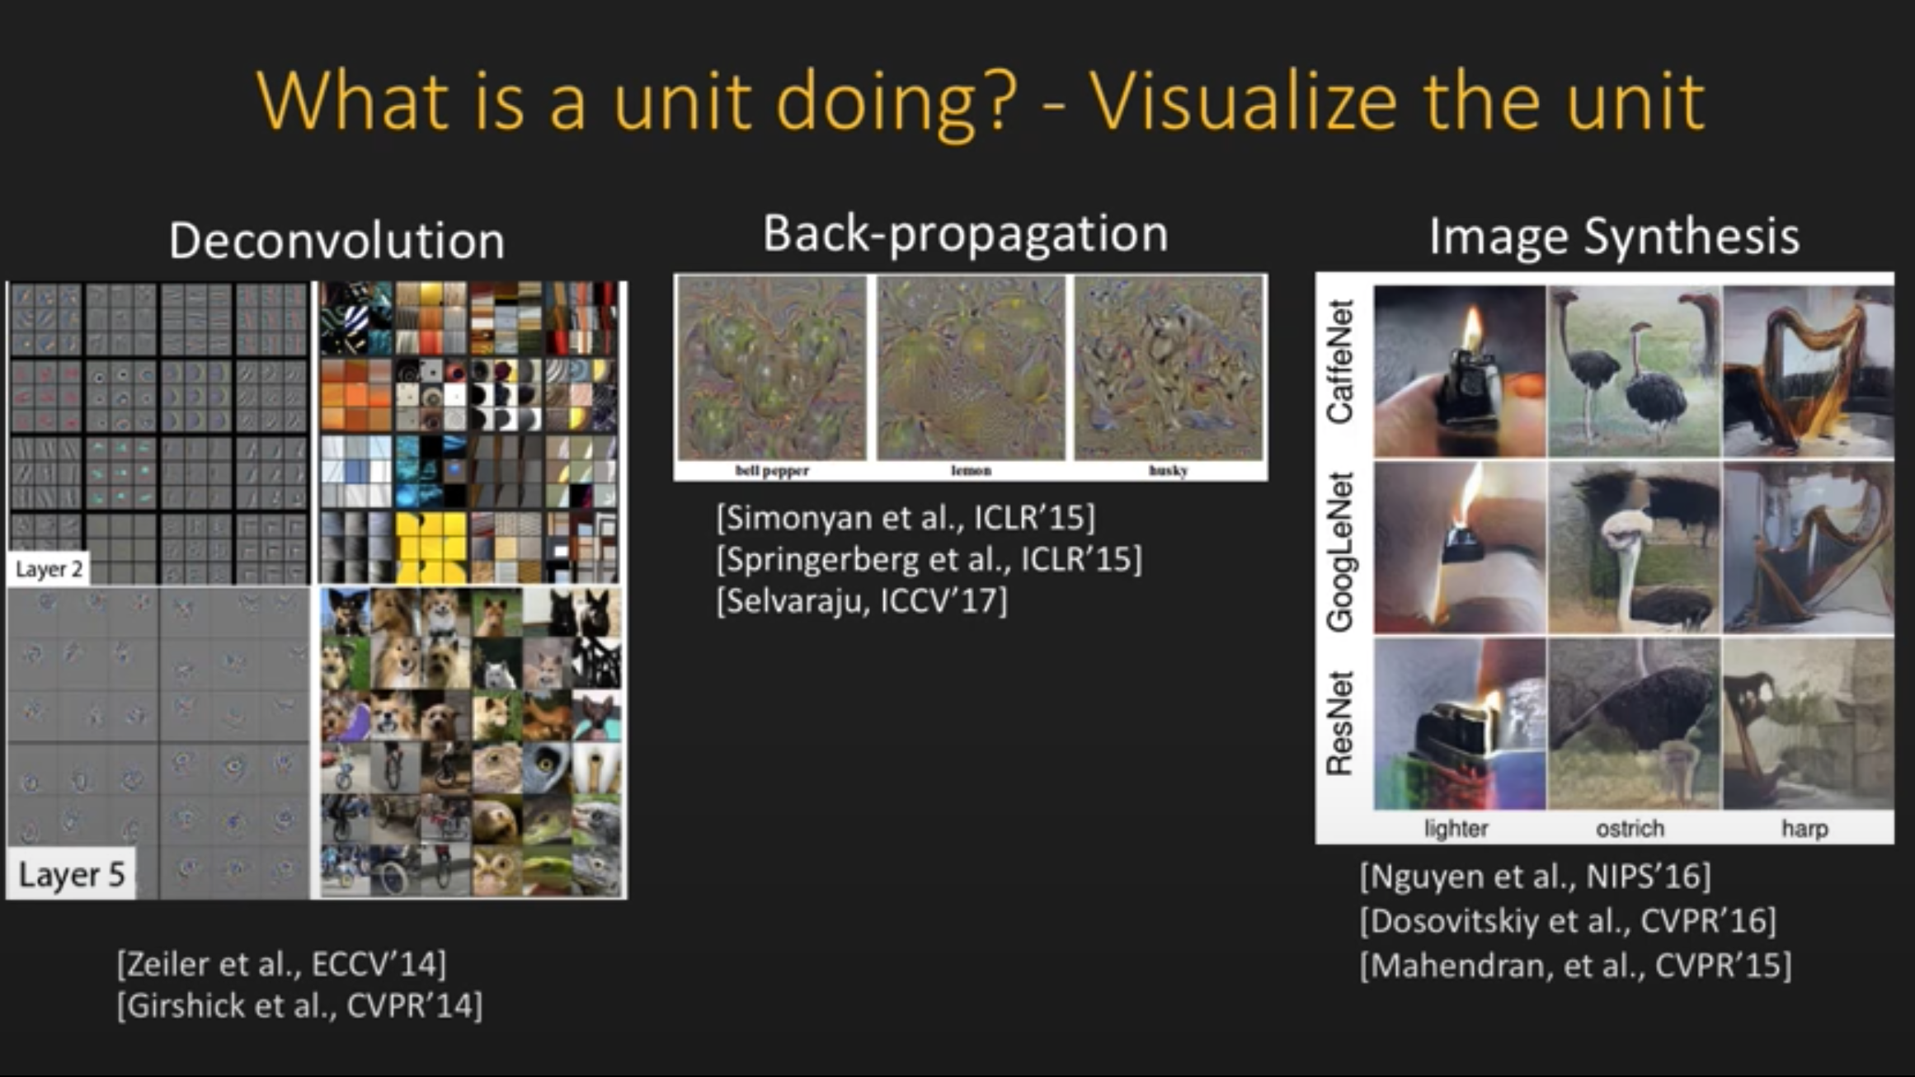
Unitwise ananlysis

